Slide 1
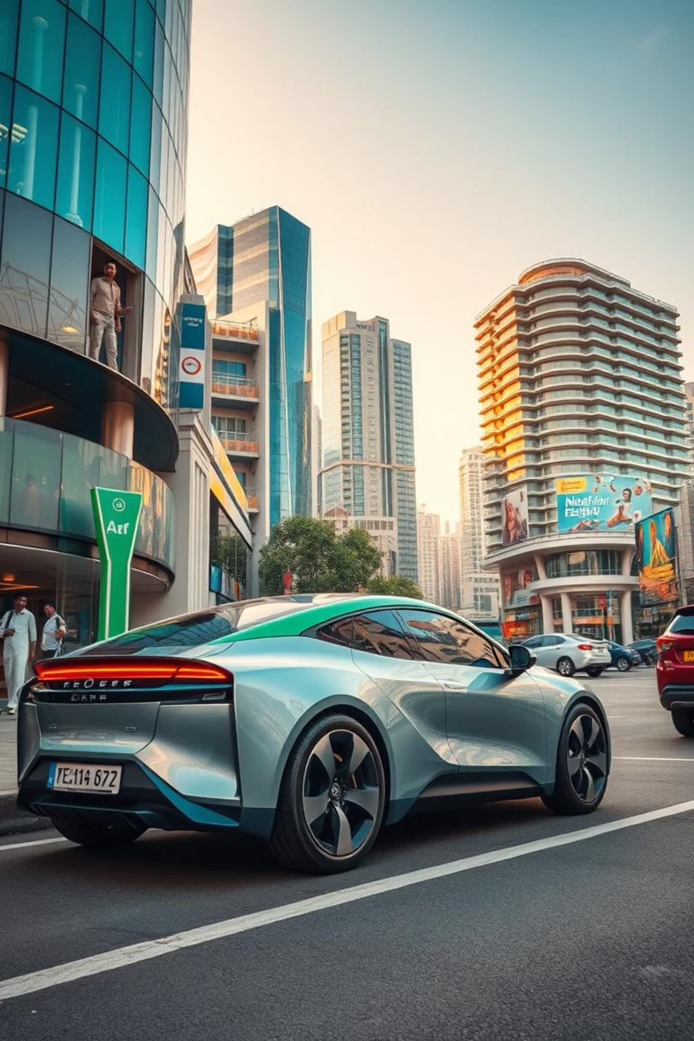
Electric Vehicle Sales in India – Exploratory Data Analysis
A deep dive into EV adoption trends across Indian states.
Discover key insights into India's rapidly evolving electric vehicle market.
VR
by Venkat G R

Slide 2

Understanding Our Dataset
We analyzed a comprehensive dataset focusing on EV sales across various Indian states.
This data, sourced from a government public portal, provides a robust foundation for our analysis.
Data Source
File Format
Government dataset from a public portal.
The data was provided in a CSV file format.
Key Fields
State/UT, Year, Vehicle Type, EV Category, Sales figures.

Slide 3
Dataset Structure Overview
Our dataset comprises a significant volume of records, offering a detailed view of the market.
Data was loaded using Pandas for interactive exploration and analysis.
Rows
15,000+
Columns
8
Data Types
Mixed (Categorical + Numerical)
Null Values
Minimal, handled during preprocessing

Slide 4

Ensuring Data Quality
Rigorous data cleaning was performed to guarantee accuracy and consistency.
This critical step ensures the reliability of our findings and visualizations.
Missing Data
Duplicate Rows
Identified and addressed any gaps or invalid entries.
Removed redundant entries to prevent skewed results.
Inconsistent Formatting
Data Type Conversion
Standardized column values for uniformity.
Converted data types to appropriate formats for analysis.

Slide 5





Exploratory Data Analysis Goals
Our analysis aimed to uncover key trends and patterns within India's EV market.
These goals guide our deep dive into the dataset.
Identify Top States
Pinpoint leading states in EV adoption.
Analyze Growth
Examine year-wise sales trends.
Compare EV Categories
Understand sales by vehicle type.
Observe Market Patterns
Identify long-term market shifts.

Slide 6
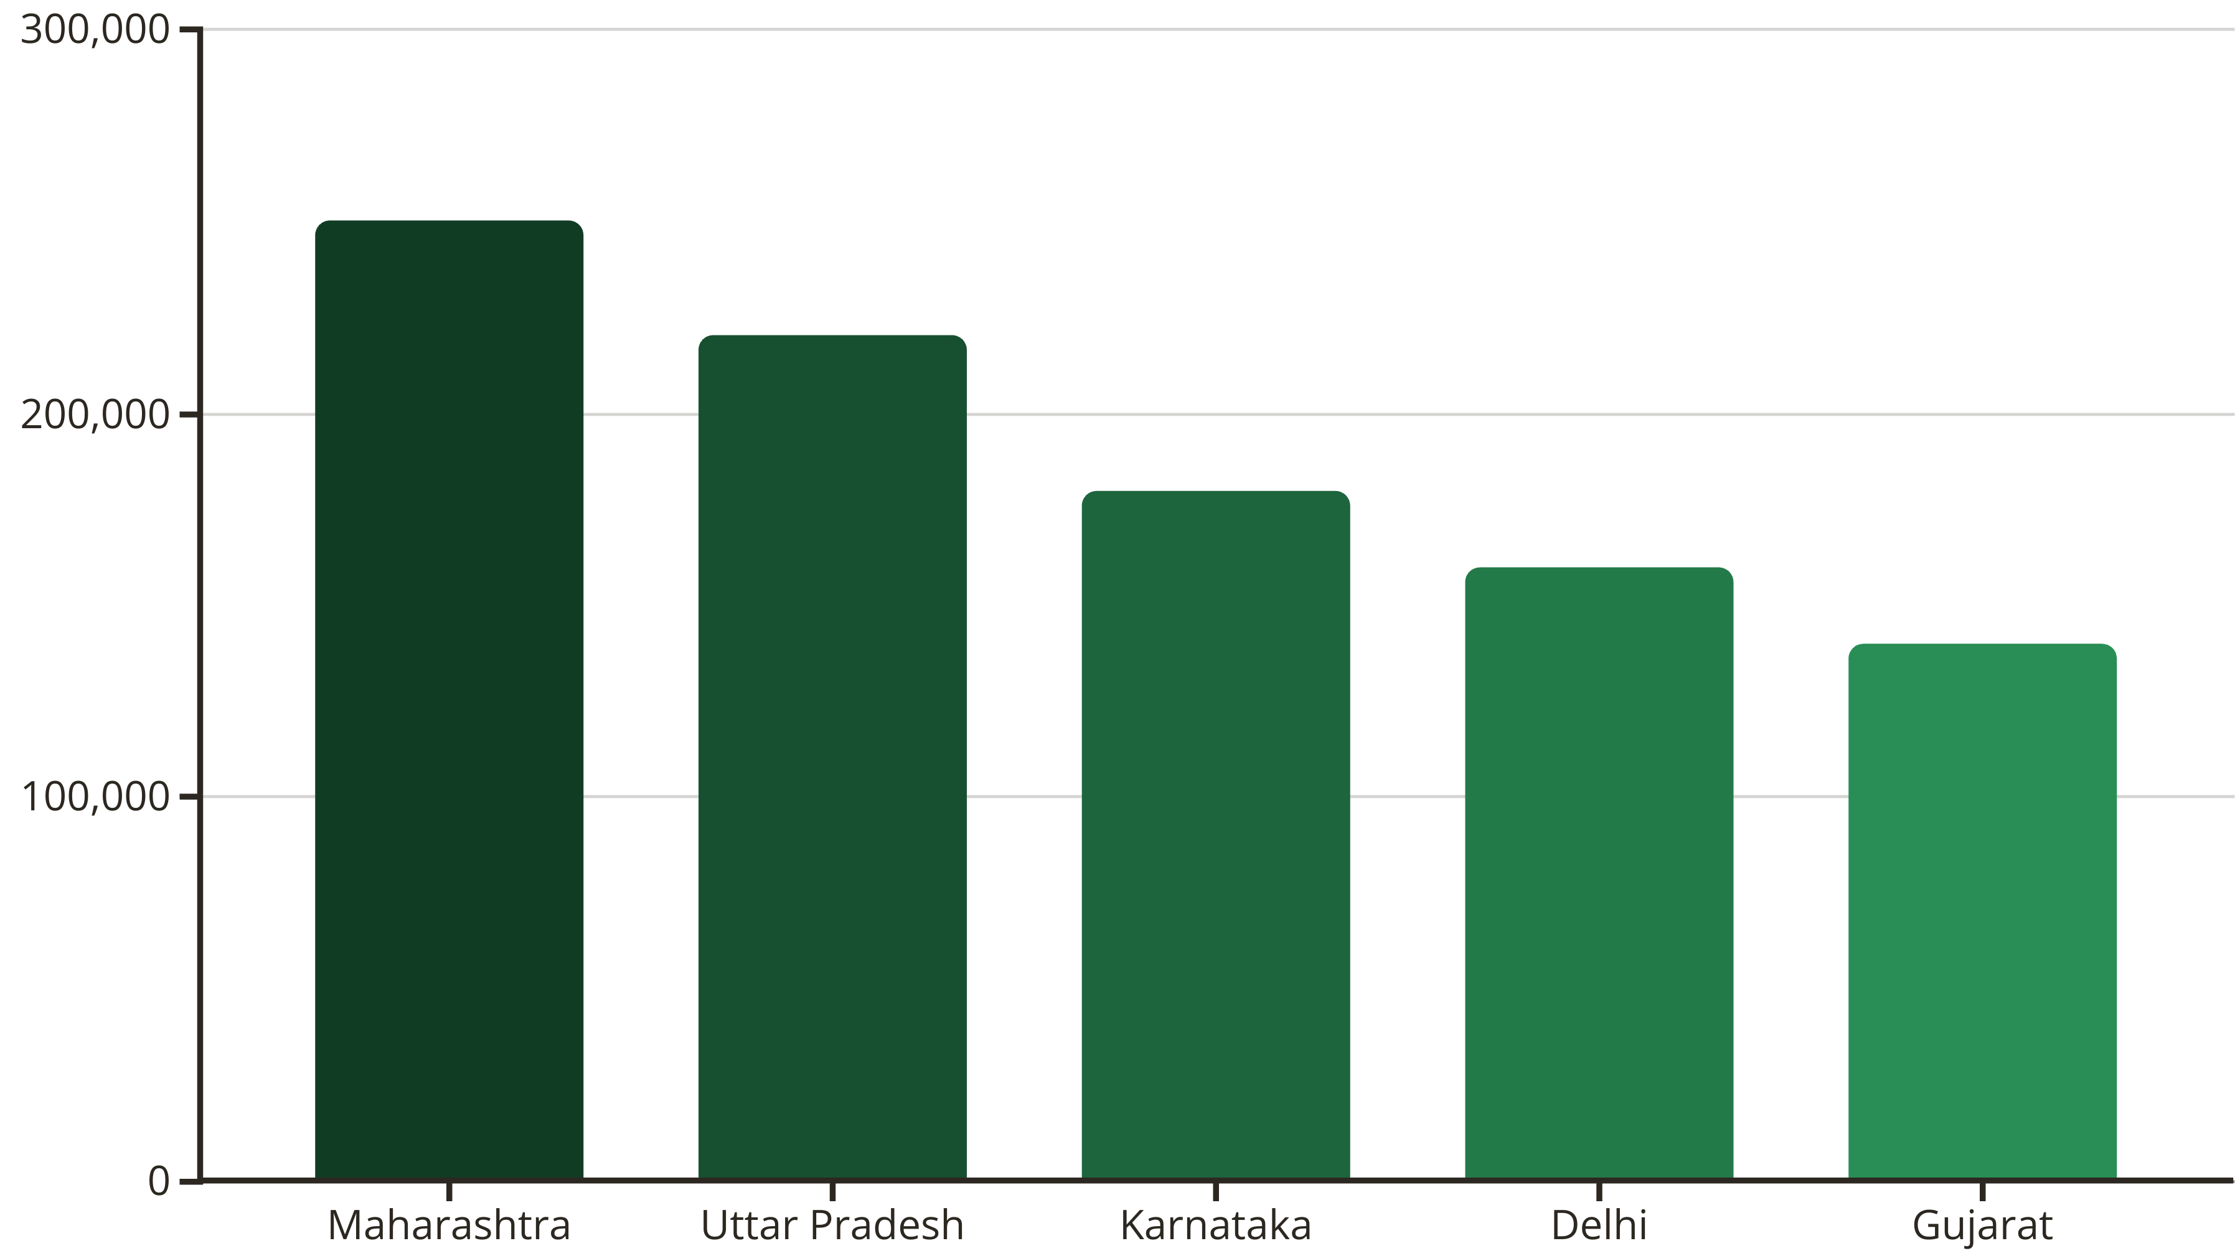
Top States in EV Adoption
Certain states are leading India's transition to electric mobility.
Their success is often driven by proactive policies and high urban demand.
States like Maharashtra, Uttar Pradesh, and Karnataka lead in EV adoption, boosted by strong government incentives and a growing urban consumer base.

Slide 7
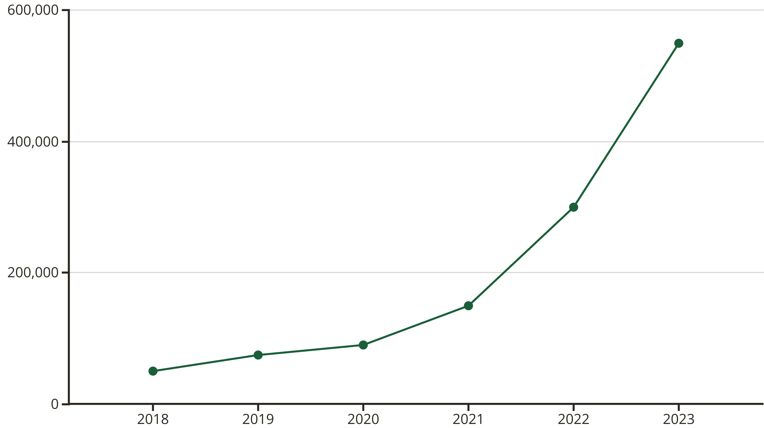
Year-Wise EV Sales Growth
The Indian EV market has witnessed remarkable growth in recent years.
A sharp acceleration indicates increasing consumer acceptance and market maturity.
A significant increase in sales post-2020 signals rapid market acceleration. This growth is driven by policy support and rising environmental awareness.

Slide 8
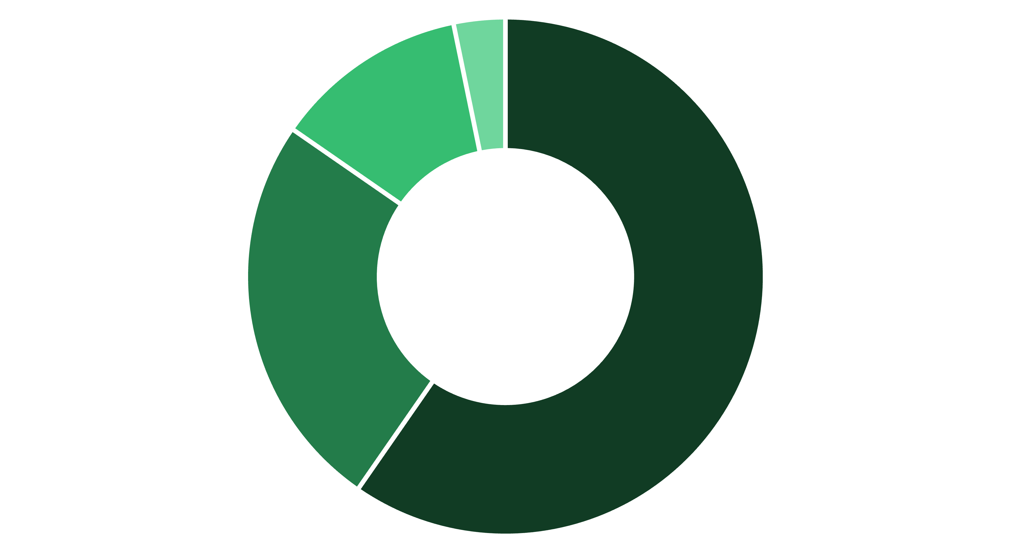
EV Category Breakdown
Different EV categories show varying adoption rates across India.
Understanding these patterns is crucial for targeted market strategies.
2-Wheelers
3-Wheelers
4-Wheelers
Buses
Two-wheelers represent the most common EV category, while buses account for the least. Usage patterns vary significantly by region and specific purpose.

Slide 9
Key Insights & Future Work
Our analysis reveals a promising trajectory for EV adoption in India.
Continued growth depends on strategic support and infrastructure development.
Consistent Rise
Urban Dominance
Rural Potential
EV adoption is steadily increasing nationwide.
Major urban states lead due to existing infrastructure.
Rural areas show significant growth potential with policy support.
Future Work:
Future studies will focus on forecasting, regional policy impact, and advanced time-series modeling for more granular insights.

